Slide 1
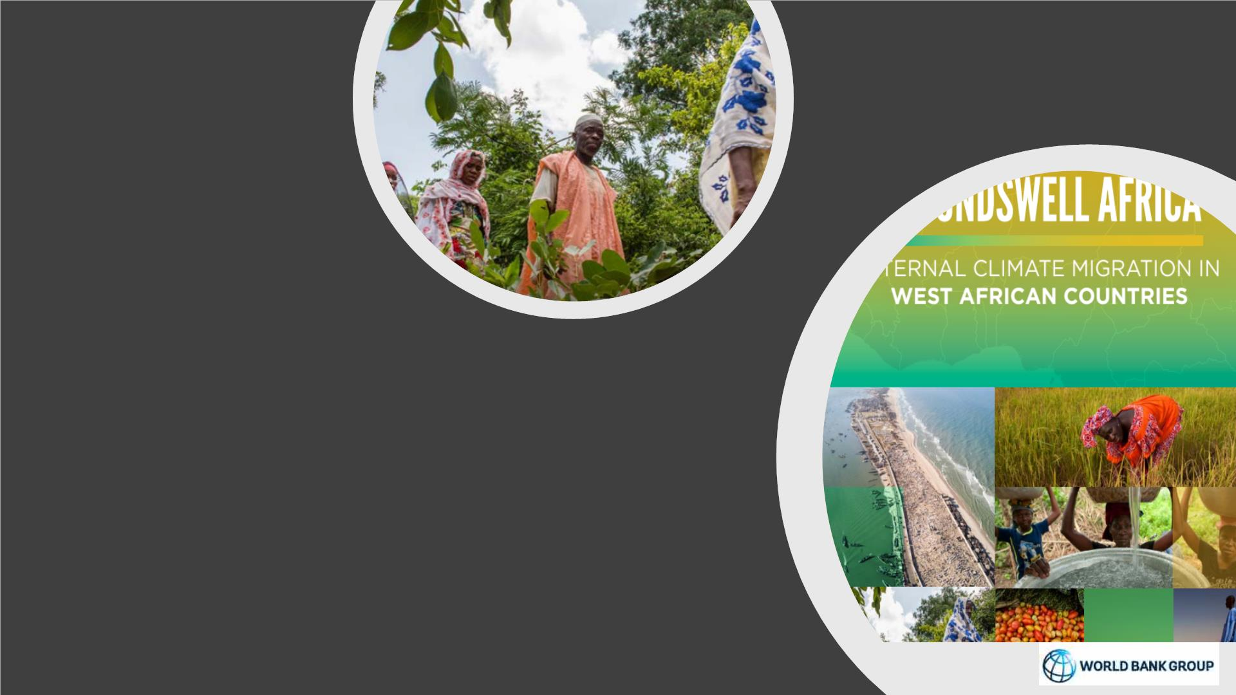
The Potency of Climate Migration in West
Africa – A Focus on the Sahel
| Kanta Kumari Rigaud
| Lead Climate Change Specialist, World Bank
| Presentation at the AFW South-South Leaning Exchange Platform
| “How Can Community & Local Dev. Support Climate Adaptation & Resilience to Climate Change
| May 24, 2023

Slide 2

Outline
I. The Context – Climate Migration
II. Climate Migration Futures – Focus on the West Africa
III. Call to Action

Slide 3

• Climate has emerged as a compounding driver of mobility along others,
including poverty, demographics, fragility or political instability.
• As climate impacts intensify and escalate, the potency for climate to
drive migration will increase.
Key
Messages
• Locality matters: and countries could see an emergence of “hotspots” of
climate in- and climate out-migration impacting the poor and most
vulnerable disproportionately.
• Urgency for far-sighted planning through landscape and territorial
approaches with a focus on inclusive, locally led development that is
green and resilient.

Slide 4
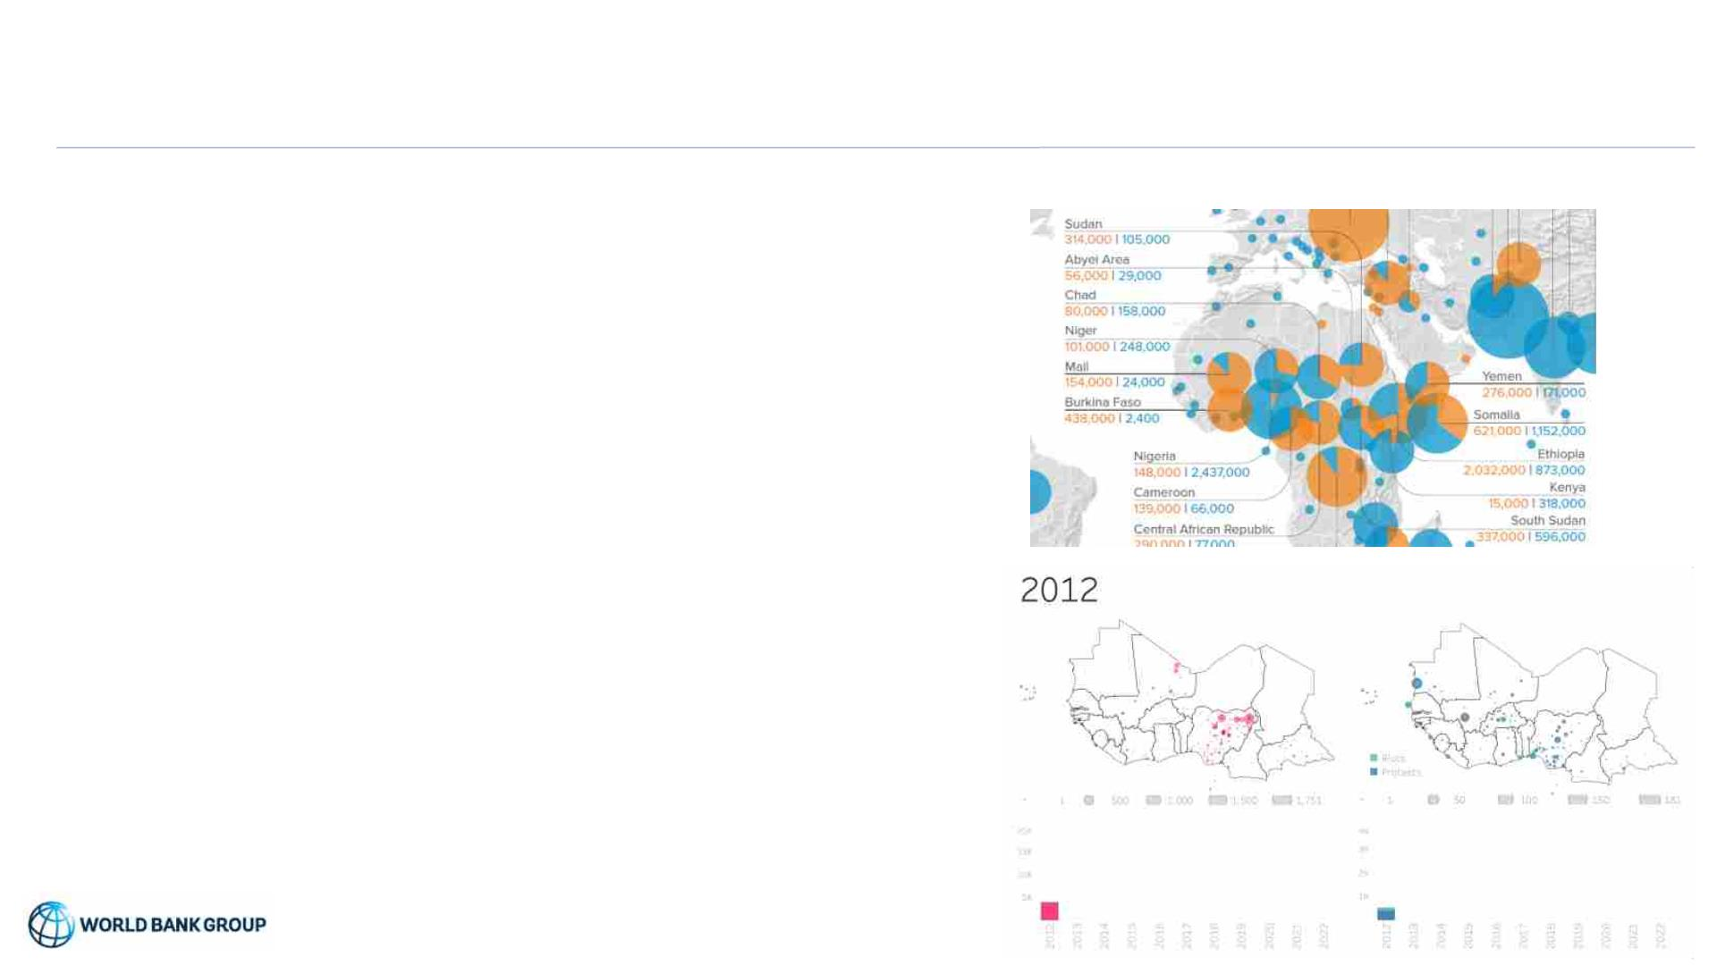
Context: The Sahel has always been a highly mobile region with increasing IDPs
• Highly mobile region with various forms of voluntary mobility
(economic, trade, nomadic pastoralism) and forced migration.
These movements have been an important livelihood strategy to
cope with Sahel’s dry season.
Internal displacements by conflict & disasters in 2022 (IDMC)
• Migration has been facilitated by the free movement protocol of
the Economic Community of West African States (ECOWAS)
• Internal mobility: rural to urban migration to both large and
secondary cities; and rural-rural migration linked to forest clearing,
overgrazing, and landscape burning
Outbreaks of violence & protests/riots 2012-22
• Displacement in Sub-Sharan Africa continues to be high
• Displacement due to disasters/hydrometeorological events
increased 3-fold since 2021
• 2.1M displaced in 2022 due to longest and most severe
drought on record with impacts on food insecurity
• Outbreaks due to conflict ((9M) outnumber disasters (7.4M)

Slide 5
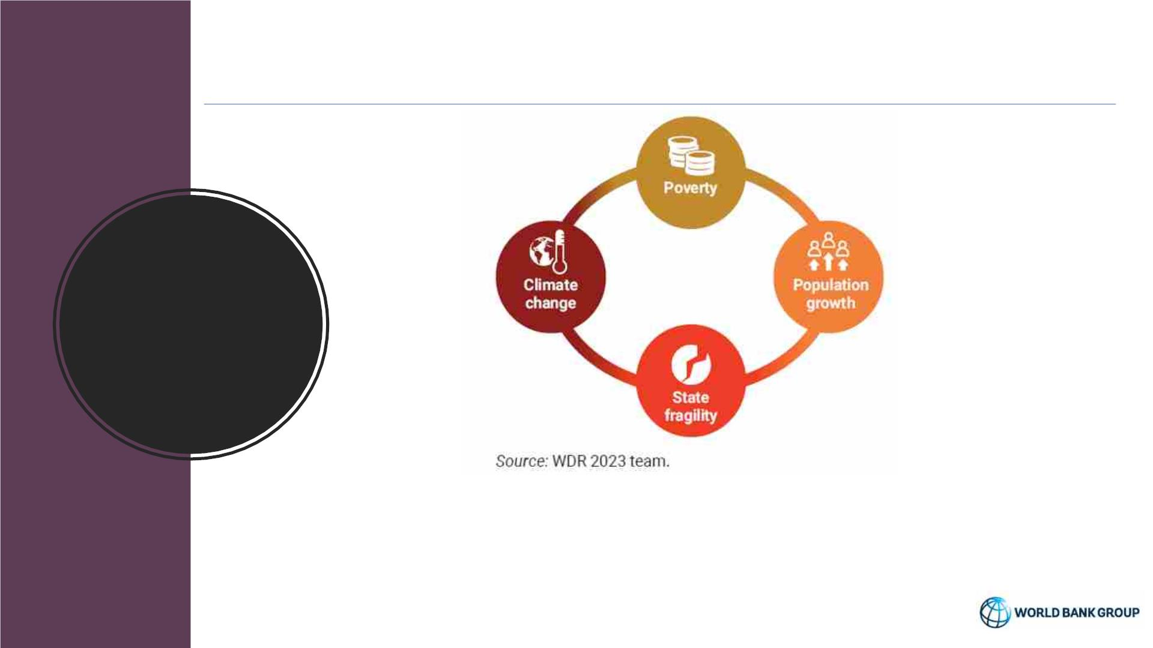
Some Intertwined Drivers of Mobility
Framing
the Issue
• Poverty, state fragility, population growth, and climate change often reinforce one
another
• Sub-Saharan Africa is facing pressures on all these dimensions at once
• The Sahel exemplifies the challenges. Burkina Faso, Chad, Mali, Mauritania, and
Niger are among the world’s poorest countries

Slide 6
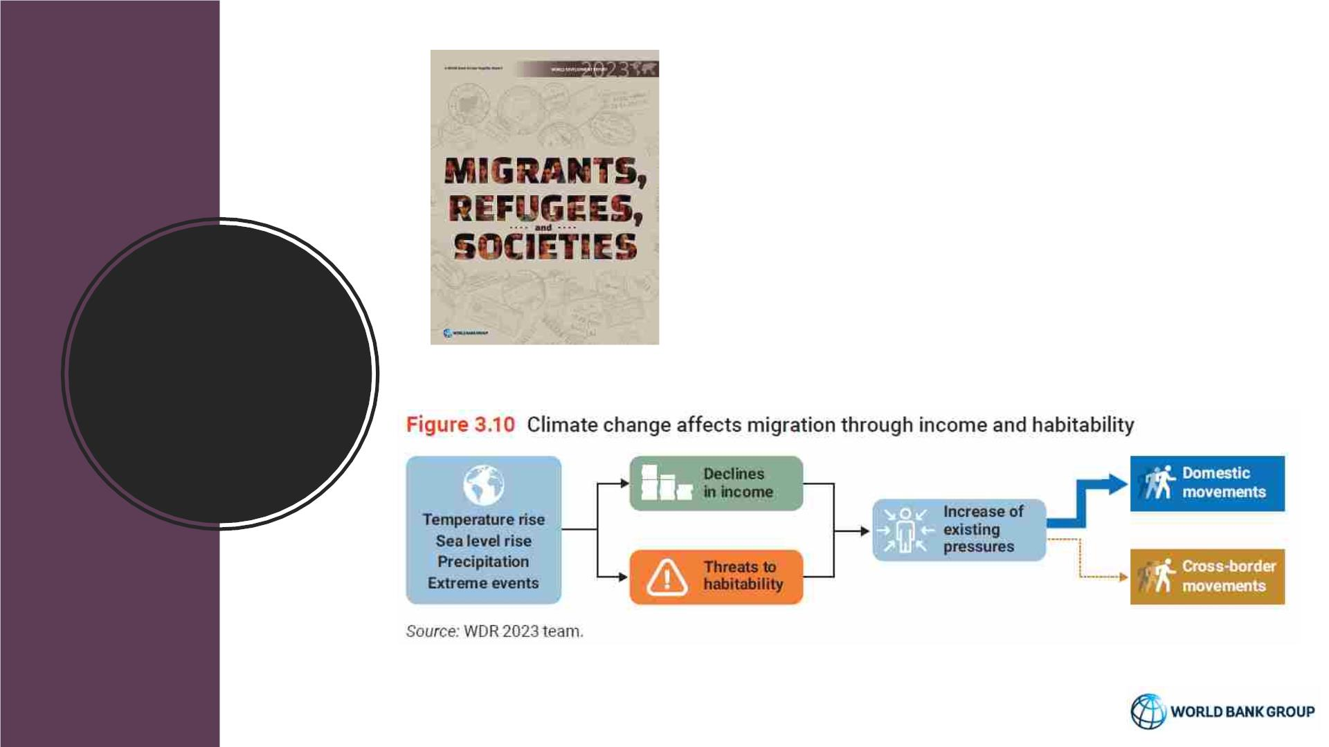
• Migration will become increasingly necessary
for countries at all income levels
• Not all migrants are the same: The Match
(skills) and Motive Matrix
• Making cross-border movements work for
prosperity and development
Framing
the Issue
Source: World Development Report 2023 (World Bank

Slide 7
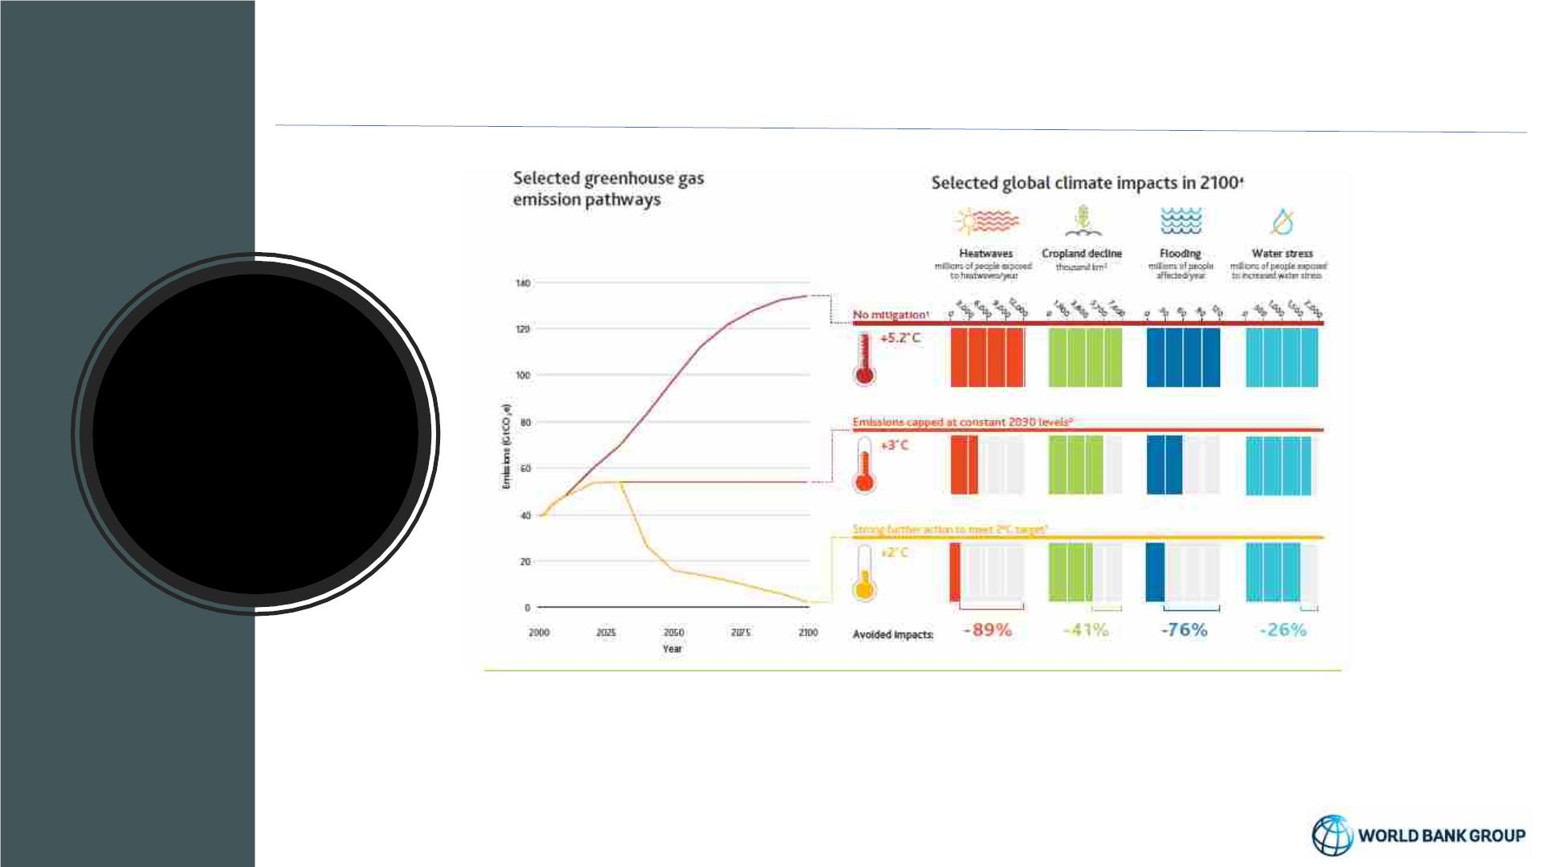
Unabated climate change will have significant consequences
Climate
emissions
and impacts
pathways
• Future climate impacts in the Sahel will be significant, especially beyond the 2°C guardrail
• 66% likelihood of breaching the 1.5C threshold between 2023 and 2027 – alarm!!
• Interaction between projected population growth and climate impacts could be very
important

Slide 8
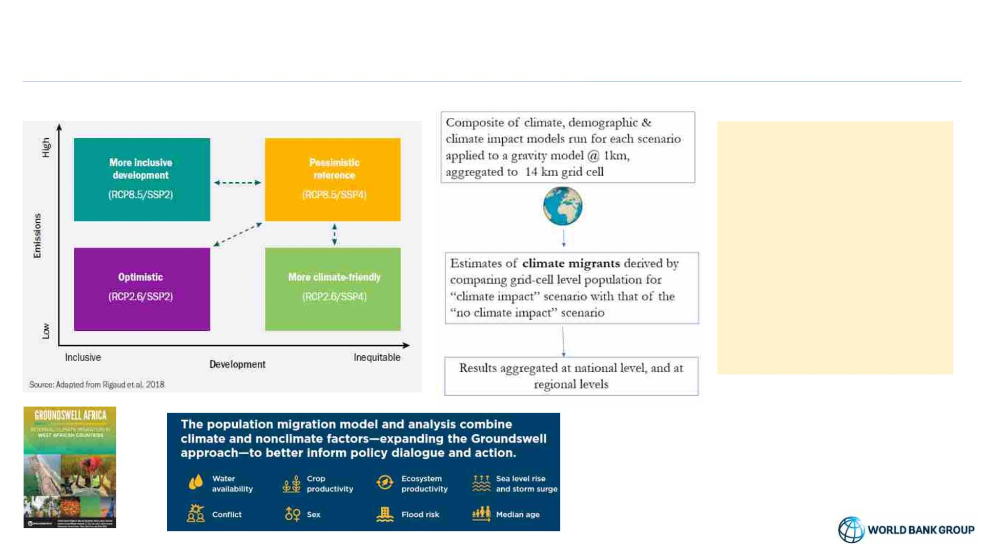
Groundswell Approach to understanding climate migration futures
• Groundswell study applies
a scenario-based
approach using state of
the art data sets to
estimate the scale of
climate induced migration
from 2020-50
• To better inform policy
dialogue, planning and
action
Groundswell Africa Series

Slide 9
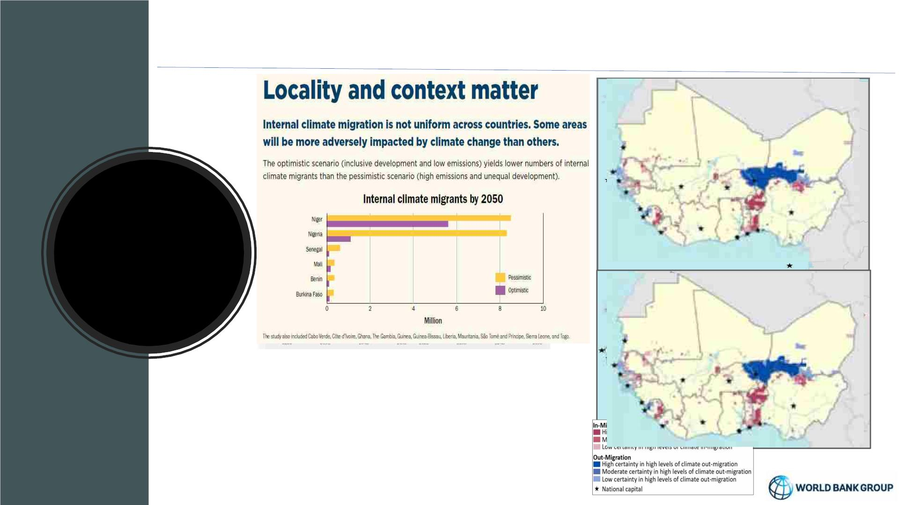
Climate change a potent driver of migration in absence of concrete action
Climate
induced
migration –
Results West
Africa
• Climate migrants – could reach an average from 7.4 million
(optimistic) to 19.3 million (pessimistic) by 2050
• Emergence of hotspots – as early as 2030 with movement from
less viable areas to areas with better opportunities
• Locality matter - migration hotspots are not pre-destined but
will depend on early and concrete climate & development action

Slide 10
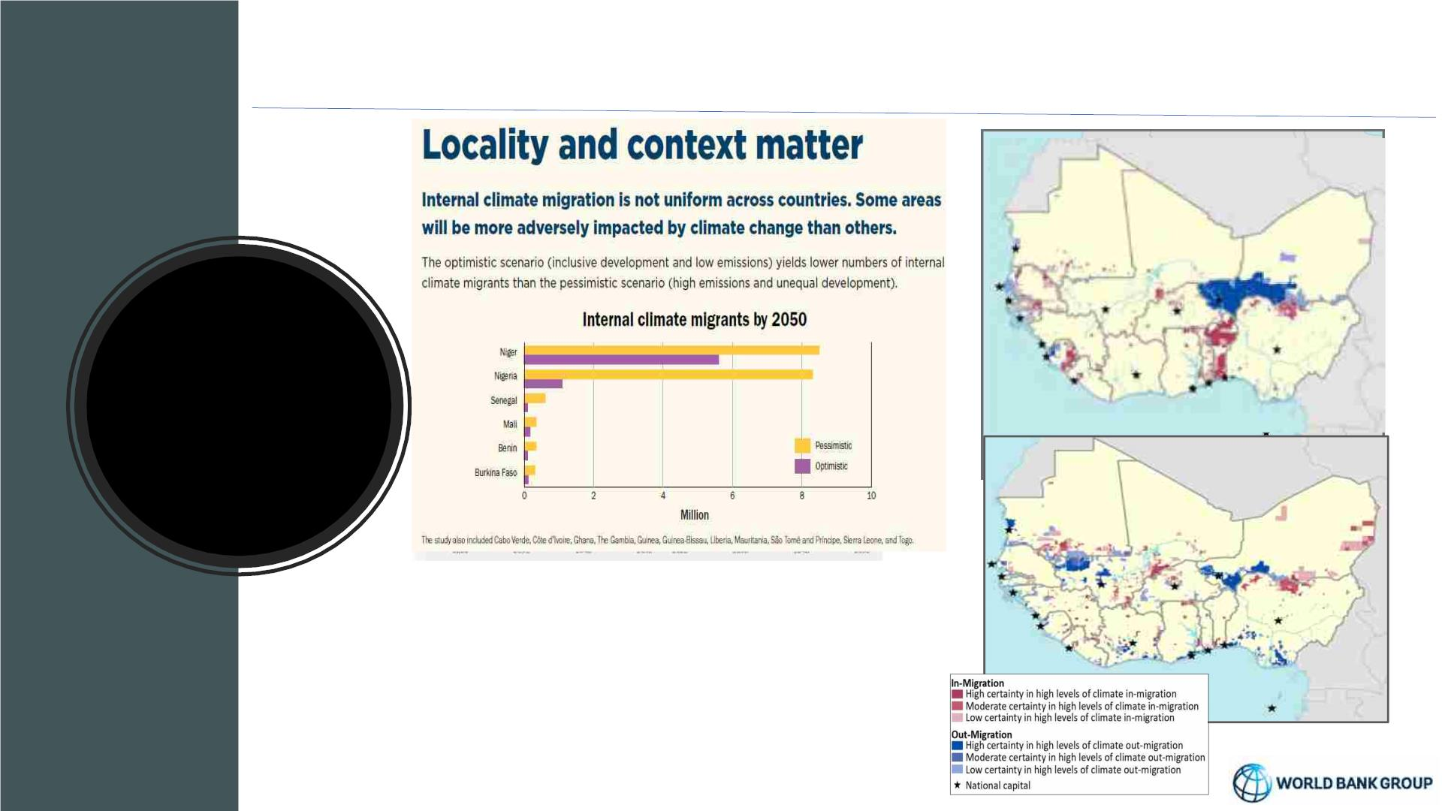
Climate change a potent driver of migration in absence of concrete action
Normalized by population 2050
Climate
induced
migration –
Results West
Africa
2050
• Climate migrants – could reach an average from 7.4 million
(optimistic) to 19.3 million (pessimistic) by 2050
• Emergence of hotspots – as early as 2030 with movement from
less viable areas to areas with better opportunities
• Locality matter - migration hotspots are not pre-destined but
will depend on early and concrete climate & development action

Slide 11
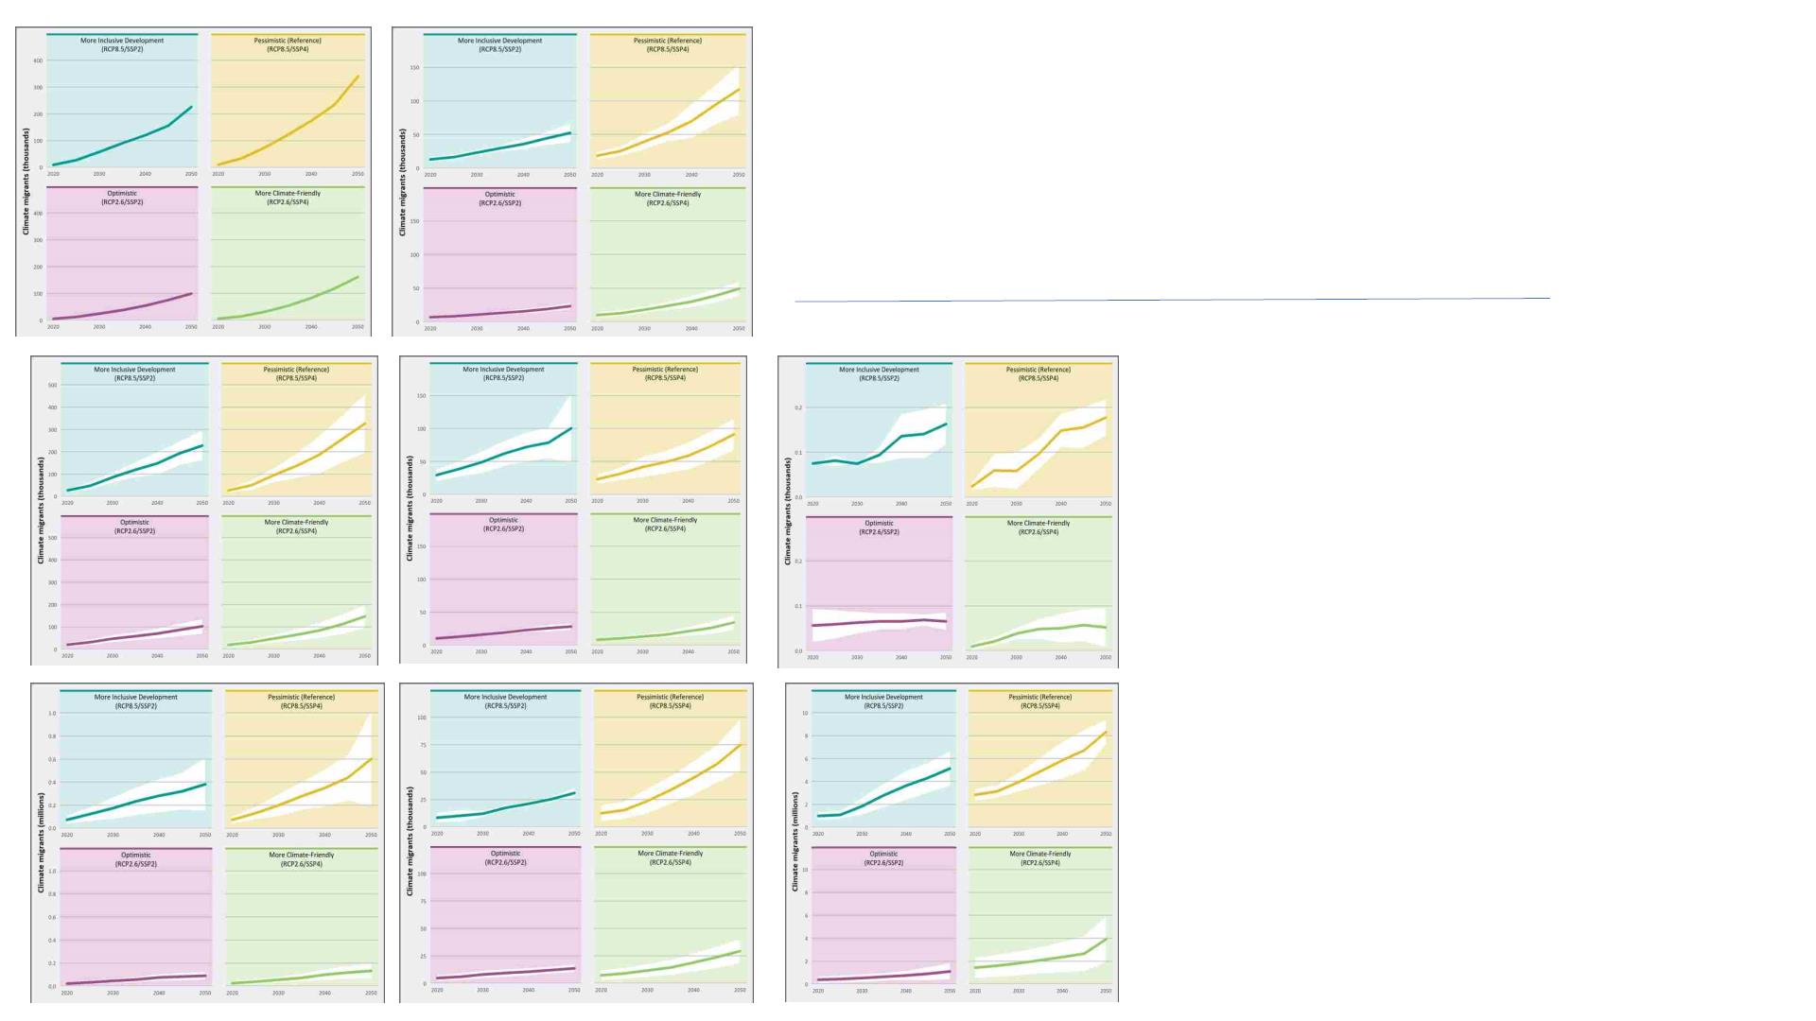
West Africa - climate induced
migration trends upwards across
all scenarios(1)
Benin
Cote d’Ivoire
• Climate migration trajectory reflects climate
induced spatial population shifts from 2020-
50
• Pessimistic scenario displays a higher pace
of increase in most cases
• Some countries exhibit more uncertainty
(e.g.. Senegal, Nigeria, STP)
Sao Tome &
Principe
Ghana
Mauritania
• Climate migrants in 2050 are 1.0 %– 2.37%
of total population (including hinterland
countries)
• Sao Tome – modelling done @1km
because of scale – so not comparable with
others
Sénégal
Togo
Nigeria

Slide 12
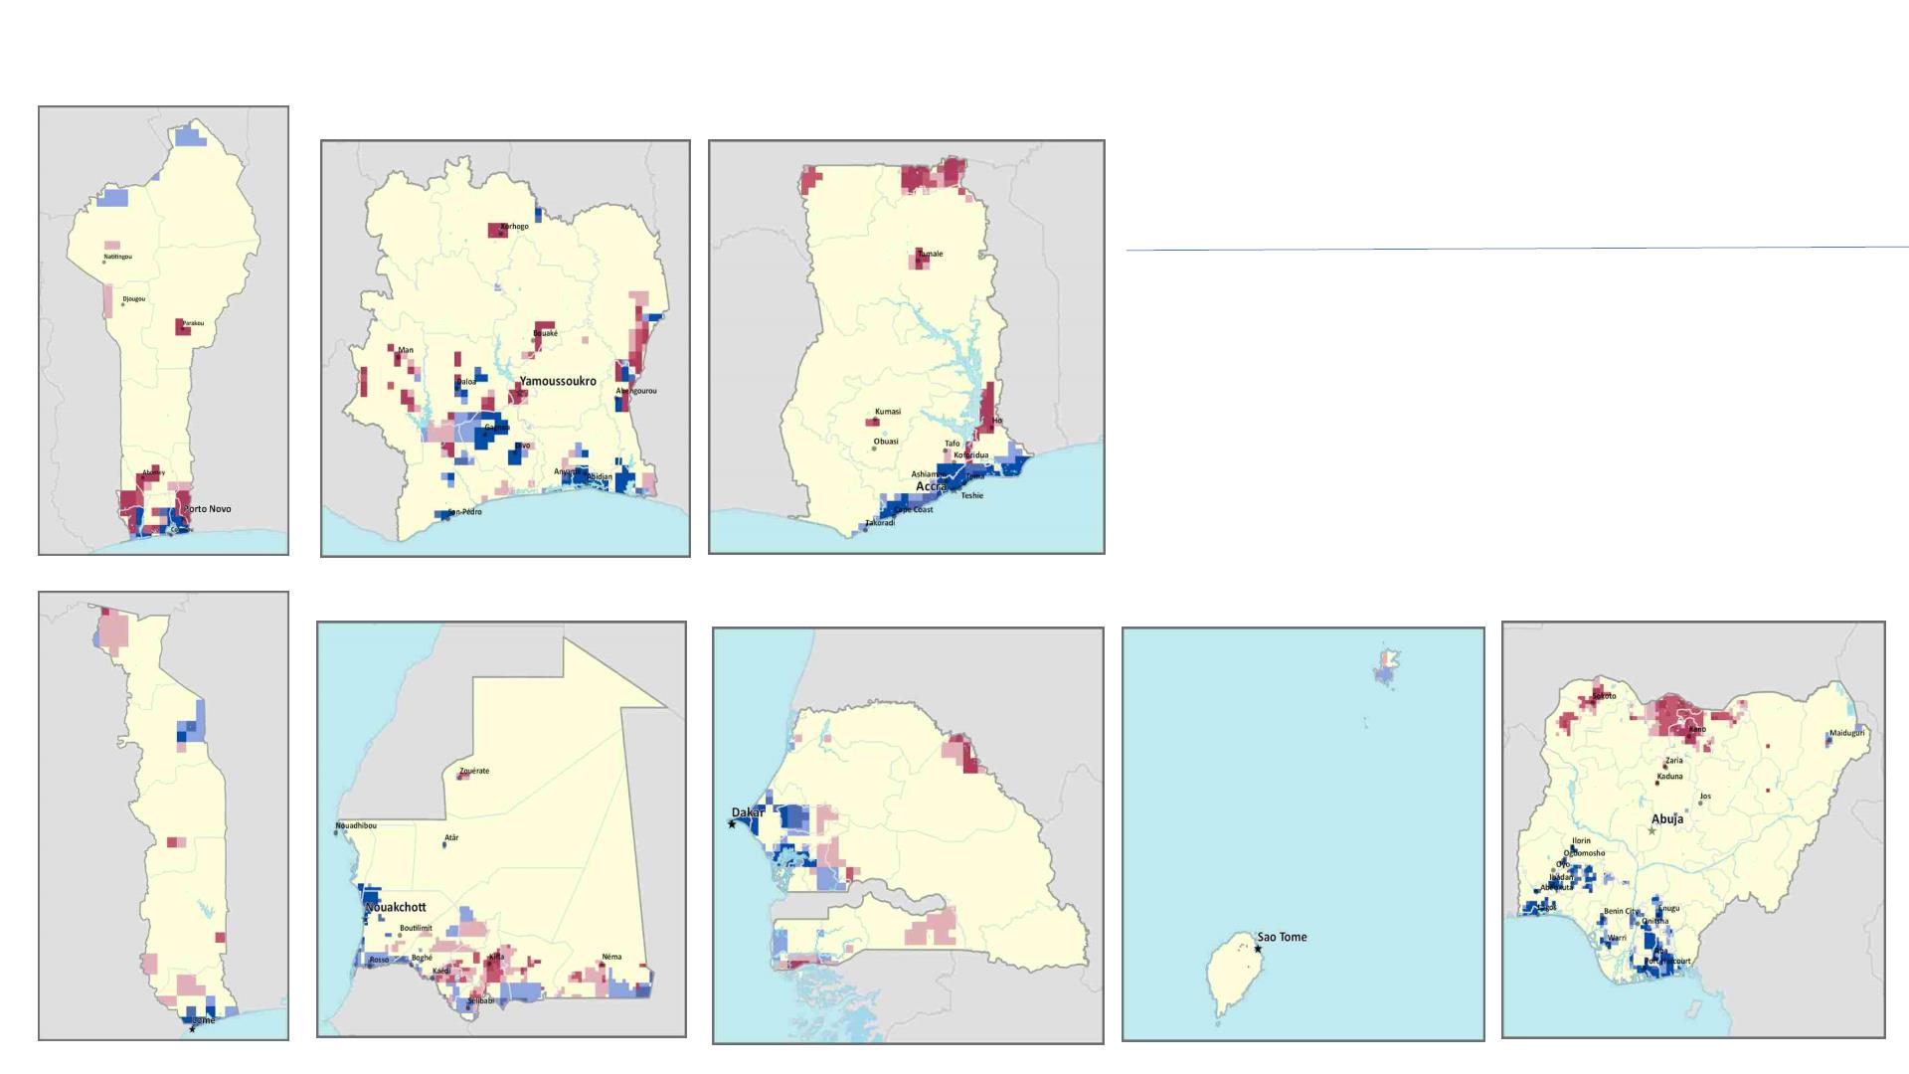
West Africa: climate migration
hotspots intensify & spread by
^{Ghana} 2050(2)
Benin
Cote d’Ivoire
• Emergence of climate migration hotspots
as early as 2030
• Reflect losses of viability of ecosystems
and habitability
• Opportunities for far-sighted planning
and action
Togo
Mauritania
Sénégal
Nigeria
Sao Tome &
Principe

Slide 13
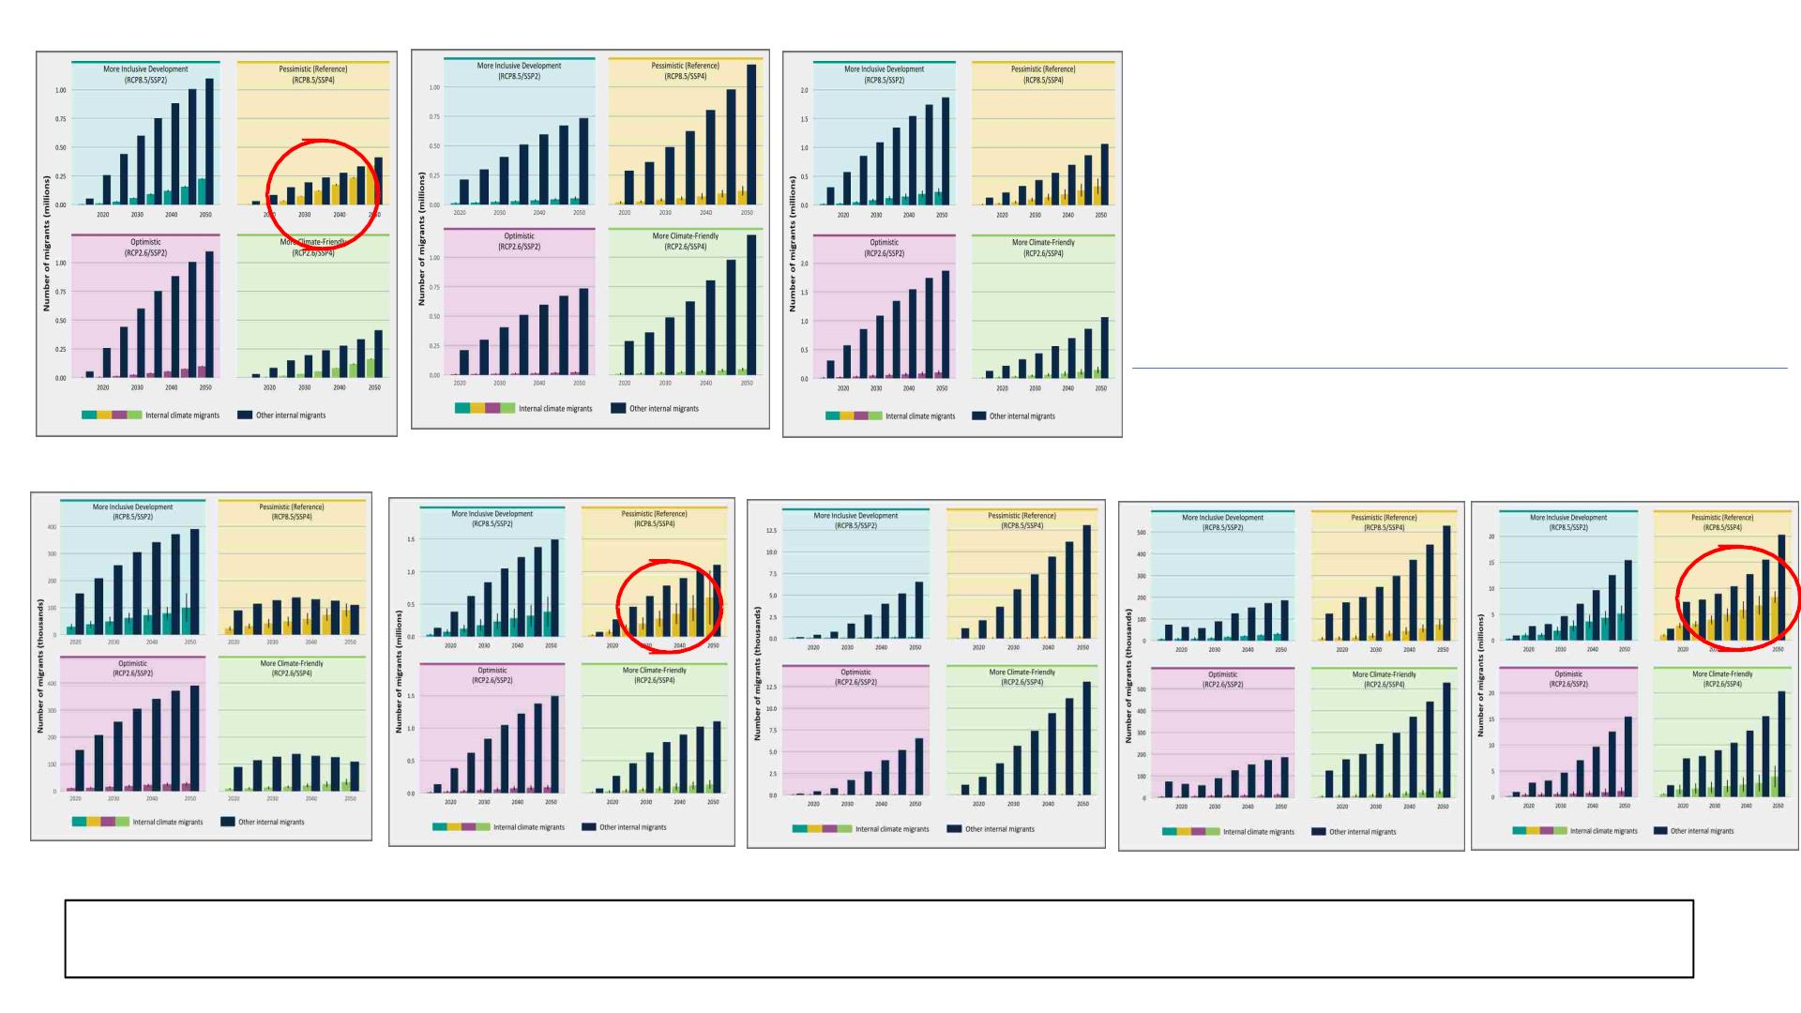
West Africa : share of
climate migrants against
other migrants varies
across countries (3)
Benin
Cote d’Ivoire
Ghana
Sénégal
Sao Tome &
Principe
Togo
Nigeria
Mauritania
While climate migrants as a % of total population remain relatively low for coastal West Africa – it can make up a significant proportion of all
migration by 2050, particularly under the high emissions scenarios, and significantly so for countries like Benin, Senegal and Nigeria

Slide 14
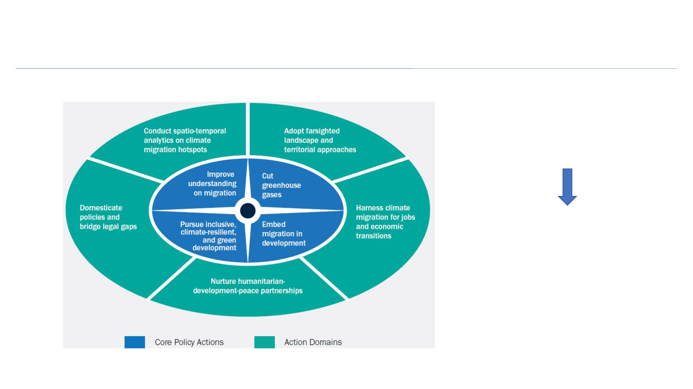
An end to end “Migration & Climate Informed Solutions Framework”
Action is needed in key policy areas
and action domains at the intersection
of climate, migration, and
development.
Support
of
development,
humanitarian, and peace partners
alongside local, national and global
actors to avert, minimize, or reduce
distress driven migration and harness
opportunities through economic and
urban transitions

Slide 15
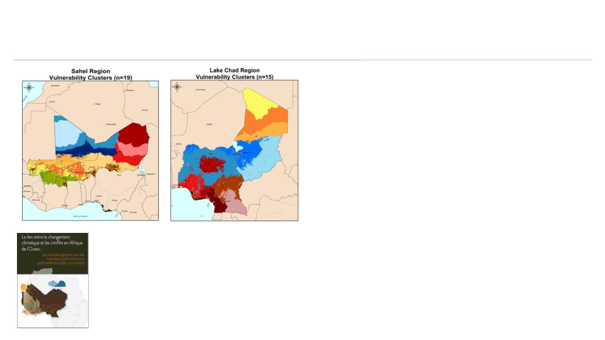
Advancing local action: Operationally relevant vulnerability assessments
• Creating vulnerability clusters for localities with
similar profiles provides valuable evidence for
thinking regionally acting locally.
• Helps develop community-centered adaptation
plans, using location specific vulnerability
information
Ø Basis for locally driven climate action tailored
to local needs and priorities; supports
• Unique climate-conflict clusters
identified for 4 sub-regions
• Sahel: 19 clusters
partnerships between governments,
communities, and civil society
• Lake Chad: 15 clusters

Slide 16

Recap
• Climate has emerged as a compounding driver of mobility along others,
including poverty, demographics, fragility or political instability.
• As climate impacts intensify and escalate, the potency for climate to
drive migration will increase.
Key
Messages
•
Locality matters: and countries could see an emergence of “hotspots” of
climate in- and climate out-migration impacting the poor and most
vulnerable disproportionately.
• Urgency for far-sighted planning through landscape and territorial
approaches with a focus on inclusive, locally led development that is
green and resilient.

Slide 17

Thank you
World Bank team: Kanta Rigaud; David Maleki; Anna Casals Fernandez; Anmol Arora; Nathalie Abu-Ata
CIESIN – Columbia University: Alex de Sherbinin, Susana Adamo
CUNY Institute of Demographic Research: Bryan Jones
Groundswell Africa is supported by

