Slide 1
Regional Knowledge & Monitoring Platform
LCBC-PROLAC

Slide 2
The KMP Application Outline
Context
Introduction
Application’s Objective & Functions
Deep Dive on KMP application
Implementation Timeline
Structures
The Future Perspective
Notes:
the operation and maintenance of a strategic, analytical and monitoring platform to foster knowledge exchange, collaboration and partnerships. This sub-component will be implemented by the Lake Chad Basin Commission (LCBC

Slide 3
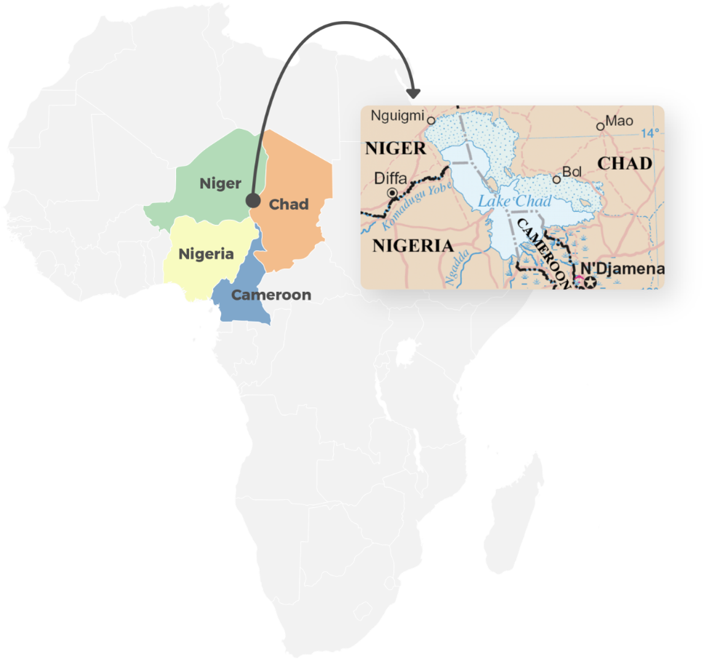
Contex
Risk factors for fragility, conflict, and violence (FCV) go beyond the national borders of one country, especially in the Lake Chad Region
Need for a holistic approach to security and development that is grounded in a better understanding of crisis risks and dynamics
Knowledge generation and management for better regional coordination – is a key priority identified in the:
  Africa Union/ LCBC Regional Strategy for the Stabilization, Recovery, and Resilience of the Boko Haram-affected Areas of the Lake Chad Basin (RSS)
Knowledge and Monitoring Platform (KMP)

Slide 4
Contex
The KMP will be financed by the World Bank under the Lake Chad Region Recovery and Development Project, PROLAC (P161706)
The KMP will be led and managed by the Lake Chad Commission Basin (LCBC). It will be:
  Built on the existing Lake Chad Information System (LIS) which focuses on the transboundary integrated water resource management of the Lake Chad Basin
  Developed in close collaboration with key development partners like the United Nations Development Program (UNDP) and Agence Française de Développement (AFD)
Past work by consultant firms on the KMP and stakeholder consultations:
  Elaboration of the design and pilot of KMP for decision-making by Stockholm International Peace Research Institute, SIPRI (Dec 2019)
  Development of a multi-layered data center by AHT (Jan 2020)

Slide 5
Introduction
The KMP Application Overview
PRPLAC Sub-Component 1a: This sub-component requires the Lake Chad Basin Commission LCBC to operate and maintain a strategic, analytical and monitoring platform that will facilitates coordination, collaboration, and knowledge exchange, among all stakeholder and the Lake Chad Region.
The KMP Application will be a multi-layer datacenter and web-hosted platform for monitoring and evaluation and a decision support tool.
Notes:
the operation and maintenance of a strategic, analytical and monitoring platform to foster knowledge exchange, collaboration and partnerships. This sub-component will be implemented by the Lake Chad Basin Commission (LCBC

Slide 6




Why?
INFORMATION
KNOWLEDGE
DIALOGUE
Do policy-makers have the data to understand FCV drivers and development challenges in the region?
Yes
Is the data analyzed to inform policy making and local investments?
Yes
Does the analysis lead to a common regional action plan or response?
No
No
No
Constraints
Constraints
Constraints
Data source not trusted/verified
Data isn’t updated
Data is inaccessible (no hardware/software)
Data is scattered
Data is unavailable
Data lacks granularity
Data analysis can be time-consuming and challenging
Lack sectoral knowledge to interpret data
Comprehension gaps
No incentives/interest
Findings are not shared
Poor stakeholder dialogue
Infrequent coordination
Misalignment of incentives
Solutions
Solutions
Solutions
Integrated data center
Capacity building for improved data collection/monitoring
Community-based data collection
Project/investment tracking
Hardware/software solutions
Commission studies in partnership with think tanks/universities
Actionable sectoral diagnostics by FCV drivers
Field visits/studies to document innovations and best practices
Capacity building for data analysis
Regional workshops and forums, including with LGs
Public commitments of regional and LG leaders
Capacity building for joint planning

Slide 7
System Requirements
No duplication: build on existing Lake Chad Information System (LIS)
Multi-language: provides information in both English and French
Online/Offline: mobile offline access to expand user base to LGs and communities
Public/Private: include login access for sensitive and confidential data
API Integration: integration with data sources & partner applications
Agile Development: follow an agile software development methodology to provide flexibility and adjust to changing needs
Human Centered Design: engage users as co-creators by testing the prototype to ensure uptake
Notes:
the operation and maintenance of a strategic, analytical and monitoring platform to foster knowledge exchange, collaboration and partnerships. This sub-component will be implemented by the Lake Chad Basin Commission (LCBC

Slide 8


KMP Objective
Improve information, knowledge generation, and dialogue through a Knowledge and Monitoring Platform (KMP) for a coherent regional response to deeply rooted drivers of fragility in the Lake Chad Region
1. Information
2. Knowledge Generation
3. Dialogue
Facilitate access to information and high-quality data to better understand the complex national and regional dynamics and existing investments.
Support evidenced-based analysis for the development of regional/cross-border policy and programming
Enhance regional cooperation among bordering countries and between partners by providing solid & neutrals grounds for discussion, coordination, and planning.
Integrated Data Center
LCB Catalogue
Lake Chad Indicators
Perception Surveys
Project Registry
Capacity building for data collection
Community-Monitoring App
Research Partnerships
Thematic Studies
Scholarships Program
Map Composer & Sector Diagnostics
Training Center
E-Learning Center
Local & Regional Reporting
International Dialogue Events
Evaluations
LCB Calendar
KMP application (web-based and mobile) – an information, knowledge, and meeting & discussion tool

Slide 9
Main Functions of the Platform
Data collection and data base creation, monitoring, integration and dissemination through a web-hosted platform;
Conflict monitoring and scenario models;
Dialogue with academic and research institutions;
Commissioning of Studies and Research;
Capacity building in data collection, including geospatial data collection, data collation and dissemination;
Decision-support tools;
Mechanism to disseminate operational results and lessons learned;
Technical Helpdesk;

Slide 10
Information Activities
Integrated Data Center: an updated and publicly available multi-layered database drawing on geospatial data, satellite imagery, raster data, and other datasets from trusted and verified sources covering the Lake Chad Region. Target: integrate 5 datasets in year 1, and 15 additional data sets years 2-5.
LCB Catalogue: a centralized catalogue of existing regional studies with executive summaries in both English and French & a quantitative and qualitative snapshot study based on the literature and document review. Target: complete by year 1, then update on subsequent years.
Lake Chad Indicators: multi-dimensional indicators used to monitor and compare developments on several axes, including governance, socio-economic development, security and social cohesion, collected through surveys. Target: agree on indicators by year 1, then update based on perception surveys.

Slide 11
Info Act…..
Perception Surveys: community panel surveys in selected localities using a mix-methods approach. Target: baseline survey on year 1, plus seven rounds of perception surveys on years 2-5.
Project registry: mapping project investments by sector, partner, and coverage. A private version could include village level investment information to support project targeting. Target: launch as part of KMP core app functions in year 1, then updated.
Community Applications (new): a two-way Citizen Engagement and Monitoring Application (CEMA app) to enable high frequency village level data collection and provide actionable diagnostics to inform local investments through online/offline mobile applications (subject to funding availability).

Slide 12
Knowledge Generation Activities
Research Partnerships: university sponsored regular knowledge sharing events, conferences, forums, and field research or development of specific courses related to challenges of the Lake Chad Basin. Target: 4 meetings per year.
Thematic Studies: research on multi-dimensional risks covering natural resources and climate change, service delivery and governance, justice and land, economic development, and security and power. Target: 2 regional reports per year.
Scholarships Program: Scholarships for selected PHD students in partner universities to conduct research on priority areas related to LCB and to disseminate findings in dedicated meetings or public events. Target: 10 PHD grants for 2 years.

Slide 13
KGA ……
Dedicated Trainings: Targeted learning programs for LCBC staff, civil servants from the four member states, research partners, local governments, and CSOs covering data collection and analysis, the use of the KMP and applications, and multi-dimensional risks. Target: 4 training cycles per year with about 20 participants each held in LCBC HQ.
E-Learning Center: Facilitate training and make the platform’s knowledge and expertise more accessible to national and local stakeholders. Target: 1 system and 5 courses.
Map Composer & Sector Diagnostics: system-generated diagnostics drawing on integrated data center to display information to display key trends, gaps, and messages. Target: launched as part of KMP core app functions in year 1, then updated.
Community Highlights (new): field visits to document local best practices & report on local stories to highlight best practices and share lessons. Target: TBD

Slide 14
KMP Application: Functions &
Dataset Development
Core Software Development for KMP (year 1): focused on 9 core functions and 5 datasets
“About”: introduction and general description of the LIS, its partners and history;
“Geoportal”: it will be divided in several topics (for example “Water”) and give access to the interactive map; Map composer
“E-Library”: further development of LIS’ document management system (DMS) and will allow central storage, organization and categorization of documents and data, shapefiles, maps or images etc.
“Projects”: mapping of interventions in the Lake Chad region;
“Dialogue”: to facilitate knowledge generation and exchange;
“Calendar and News Section”: Integration of an online calendar with the possibility to schedule events. Event related news, e.g. upcoming conferences, the launch of studies or to inform users about approaching deadlines for application to scholarships

Slide 15
“Reporting Features”: pre-defined templates for data, reports or statistics that can be exported
“Login”: accessible only for registered users.
Others: Help desk, FAQs, Online Help, Mailing List
Flexible Software Development (years 2- 4): integration of up to 15 new datasets and additional functions, with possible extensions including: Global search; Discussion board; E-Learning; Community-based applications; etc.
Capacity Building (years 1-5): capacity needs assessment, capacity building plan & training courses, implementation of up to 20 trainings and coaching, evaluation of training and capacity building activities.
System Maintenance & Backstopping (years 1-5): bug fixes of deployed functions and admin and technical backstopping

Slide 16
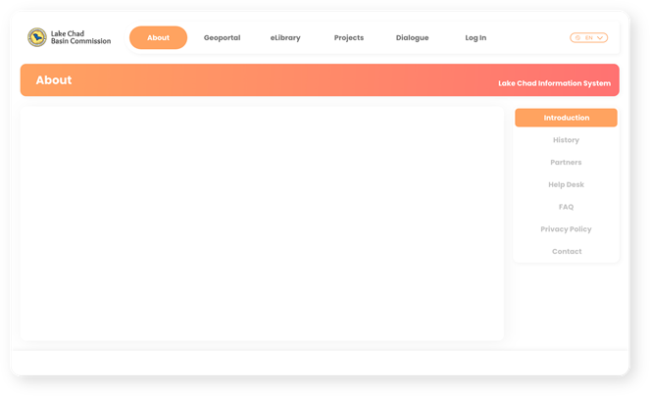
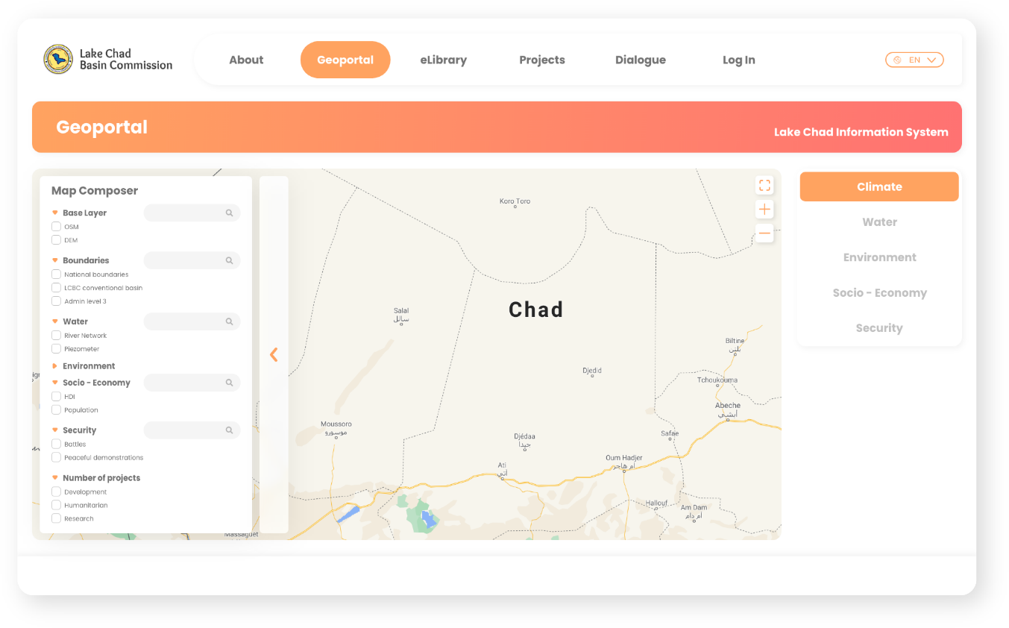
Dashboard Mockup Views

Slide 17
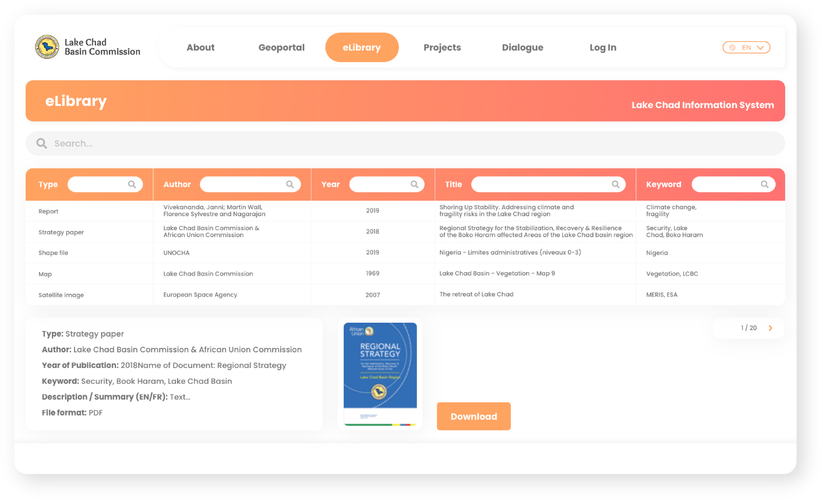
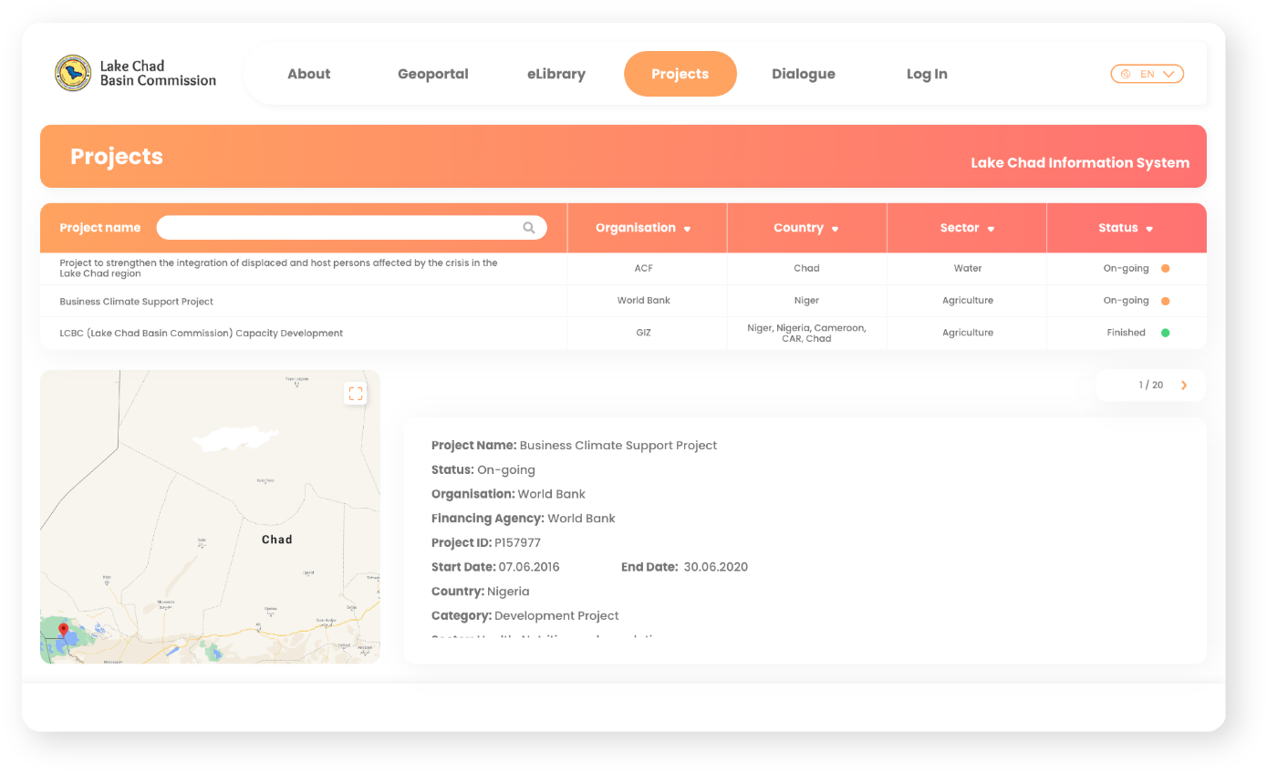
Dashboard Mockup Views

Slide 18
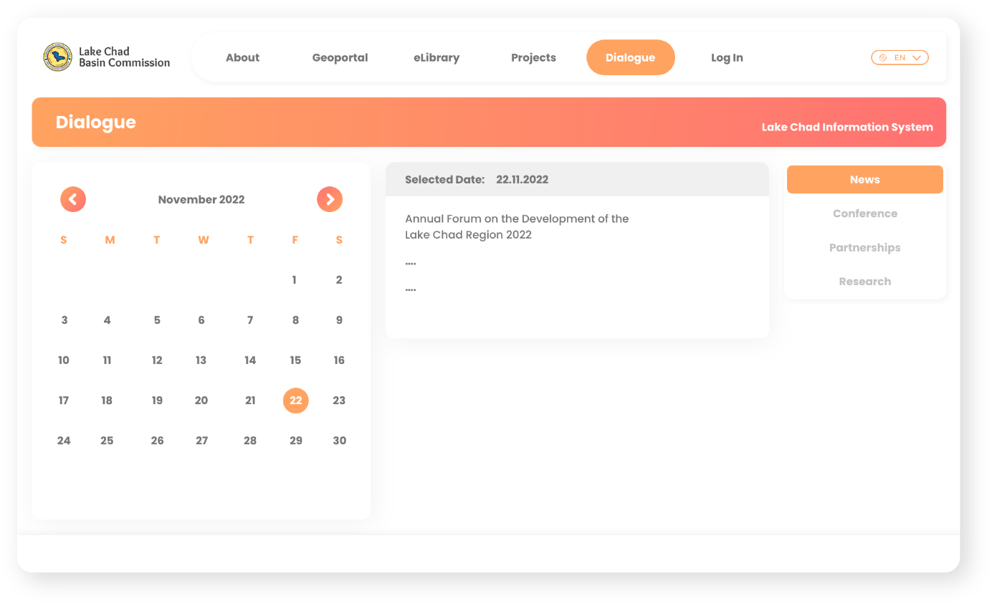
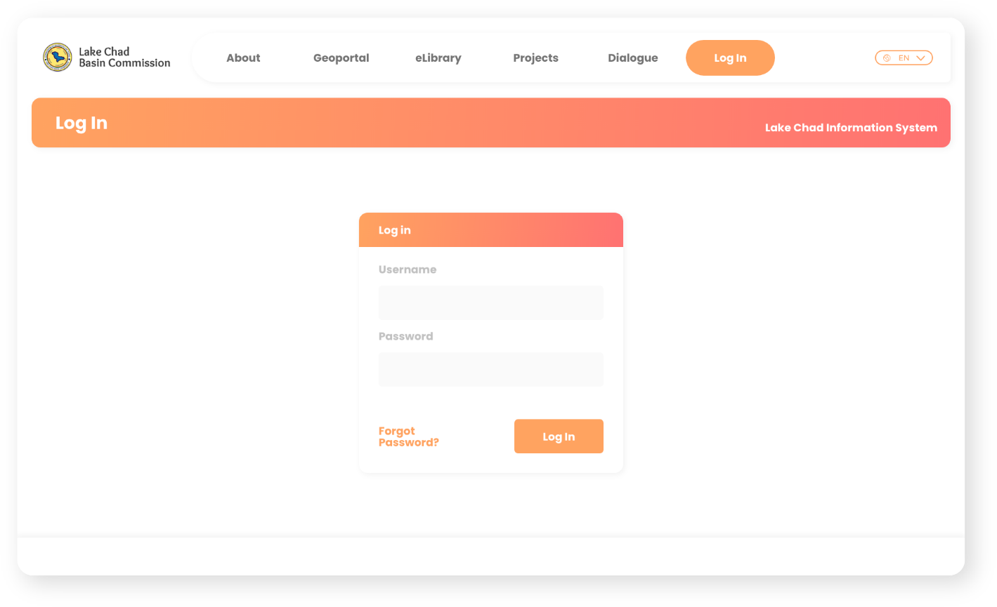
Dashboard Mockup Views

Slide 19




Datasets will draw on SIPRI’s Study on multidimensional risks in the Lake Chad region
Socioeconomic
Development
Indicators
Climate change
Governance
Security
Environmental challenges/climate Impacts
Local knowledge
Climate Policies
Accountability
Presence or absence of institutions (both formal and non-formal) and level of confidence
Quality of services delivered at state/federal/ regional/local level
Situation of the rule of law and human rights
Modes of production (agriculture, livestock, fishing, and commerce)
Mechanisms of resilience
Perception of development/ humanitarian interventions
Perception of the security situation (at the national, local and individual levels)
Strategies of the populations and communities for coping with insecurity (conflict, violence, criminality)
Perceptions of (the state, regional and non-state) security actors
Sub-indicators

Slide 20


Software Development Process
Conception
October 2020 – January 2021
Build high fidelity prototype and validate with end-users, define the system architecture, and prepare EPICs and user stories for all priority functions.
Piloting & Launch
August 2021 –October 2021
Pilot solution with selected stakeholders, solve problems, develop a capacity building plan, and support scale up.
1
2
3
Construction
January 2021 – July 2021
Develop the software following an agile methodology. Test all completed features with end-users.

Slide 21
KMP Implementation Timeline
LIS Extension / Activity | Description | Potential added value | Comments | Time frame
Dashboard | Modification of existing user interface | Intuitive search experience and one-source solution | Branding needs to be clarified (LIS or KMP) | 1st year
Map composer | General map window with the possibility to add multiple layers with export option | Creation of personalised thematic maps |  | 1st year
eLibrary | Full text search, preview, categorisation, links to other extensions of LIS (if applicable) | Online access to relevant documents with abstracts in two languages | Does not include content development; upload through registered users and quality check by LIS committee/ PROLAC secretariat | 1st year
Project registry site / project mapping | Project list with possibility to show map with delineation of project intervention zone; and categorisation according to sector or type of project (development, humanitarian and research projects) | Overview of projects and actors in the Lake Chad Region | Does not include content development; consider integration of information on implementation partners/agencies | 1st year
Mailing lists | Creation and management of mailing lists | Allows centralised diffusion of reports/newsletter/etc. to a predefined group of people | Evaluated as very useful by LCBC | 1st year
Calendar | Integrated online calendar that can be linked with other LIS extensions | Possibility to schedule events and remind LIS users |  | 1st year
News section | Tool to display news content (articles, announcements etc.) and inform about the regional coordination activities, organised under KMP | Dissemination of relevant news items | Does not include content development; could be displayed just on landing page | 1st year
Helpdesk | Software aided issue tracking with multiple layered support – link to responsible experts/support staff | Centralised user support | Requires human resources | 1st year
FAQ | Information on frequently asked questions and issues | Quick possibility to address common service issues; enhancement of user experience with LIS |  | 1st year
Online Help | Topic-oriented, procedural or reference information based on user manual | Context sensitive user support; minimizes need for face to face training session for external users |  | 1st year
Import of relevant datasets | Development of individual data import function depending on attribute characteristics and its relations of a specific dataset | Storage and access to multiple datasets in one centralised information system | During the 1st year integration of up to 5 datasets to the old LIS platform; from the 2nd year onwards integration of new datasets (i.e. SIPRI) | 1st to 5th year
Reports | Output of data/information in form of excel or pdf | Export of edited data/information stored in the LIS | Identification and specification of data outputs and format for communication | 1st to 5th year

Slide 22
Timeline …
Software service maintenance | Regular troubleshooting of LIS system and bug fixing | Permanent operability of LIS |  | 1st to 5th year
Flexible software development position | Pool of software development days to respond to arising development needs from the client / to react to updates of imported datasets (new requirements, formats, preconditions) | Fast development of extensions unforeseen at the begin of the assignment | Needs and further development will be defined during project implementation in close consultation with the client | 1 st to 5th year
Capacity Development | Trainings on specific LIS extensions; Training of trainers | Enabling more people to effectively use LIS | Training on LIS and new functionalities for: Members of PROLAC secretariat Members of LIS committee (ToT); Trainings on data protection / regulation. | 1st to 5th year
Project Management | Continuous backstopping support; regular missions to the host of the data center | Quality assurance for the global software development and performance and communication with the client and donor |  | 1st to 5th year
Feedback buttons | Small button on each sub-site with possibility to provide direct feedback on user experience | Feedback for software developers and system administrators | No immediate response for user | Optional (2nd year)
eLearning | Course management, creation of learning areas, assignments of roles, teachers and students and feedback option for teachers and trainees (Q&A) available for download | Online access to learning material | Does not include content development; does not include live training sessions; low priority for 1st year due to lack of training material available; Proposition: foster partnerships with Universities for content development | Optional (3rd to 4th year)
Discussion Board / Forum | Tree structured discussion board with messages | Possibility to post comments to a certain topic | Requires staff for moderation of the forum (not included); guided themes / topics (i.e. pillars of regional strategy); utility evaluated low | Optional
Manual | User manual in PDF format (FR and EN) | Comprehensive written guide and associated images. |  | Optional
Offline distributions | Installation of local server with user interfaces with local updates of LIS on a regular basis (i.e. each 6 months) | Access to LIS content in remote locations for users with no or weak internet access | Data protection / security not guaranteed; except NDJ no challenge with internet; not recommended | Optional

Slide 23
Relevant Stakeholders
Lake Chad Basin Commission
Central governments
Local governments
Universities, thinktanks, and researchers
Development Partners
Regional Organizations
NGOs & CSOs
Lake Chad communities
The public

Slide 24
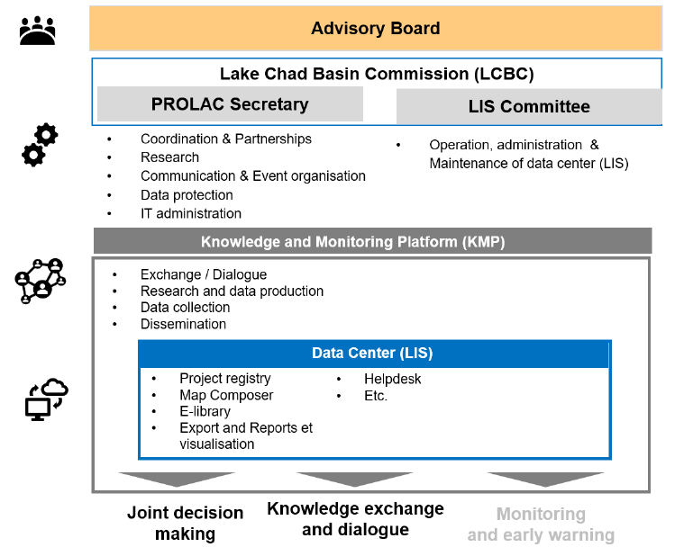
Governance Structure (Adapted from AHT Report)
To provide overall strategic oversight for PROLAC
– LCBC + Member State National Steering Committee
To manage overall coordination, including both:
Data center (LIS)
Political dialogue, partnerships and regional coordination
(see staffing for LCBC in next page)
To manage day-to-day operation & management of data center
- Includes existing 10 LCBC staff (with content managers responsible for specific themes)

Slide 25







Proposed Structure (adapted from AHT & SIPRI Report)
Support
LCBC- PROLAC Secretariat
Support (including draft statement/ action plan for Annual International Forum)
Coordinator
Specialist in Knowledge Management & Event Planning (Supported by Recovery, Reconstruction and Resilience Specialist)
Lake Chad Research Group (LCRG)
Include Research representative from the National PIUs (Cameroon, Chad, Niger, Nigeria)
Meet 1-2 times a year
Facilitate/
Coordinate
Communication
ICT & Database Specialist
IT Expert
Data Analyst
Commission & Coordination of Studies
Event Organization
System Maintenance & Admin Support
Data availability and quality
Liaise with
Administration of Help Desk
Liaise
with
Scholarships/ Publications
Comm-unication
Terms of Data use
Each Partner University
(A Focal Point, An Admin/Finance assistant)
Science Partnerships
Political Partnerships
Data Protection
GeoServer

Slide 26
How can PROLAC 1(a) & 1(b) reinforce each other?
Some Activities under PROLAC Subcomponent 1(a) – LCBC PROLAC PIU
Activities under PROLAC Subcomponent 1(b) – National PIUs (with academics)
Capacity Building
Infrastructure investments; Set up new units/ institutes Data collection support Training
KMP Software Development
Guide research priorities to fund
Inform themes for exchanges/ events
Database/GIS; E-library; Project Registry etc.
Enhance capacity to generate knowledge
Knowledge Generation
Research support/ studies commissioned Research grant/ fellowship program
Dialogue Platforms
Feed data & findings/analysis into KMP
Consolidate key findings for regional dialogue & decision making
Support dissemination; translation into decision making
Organize Annual International Forum on the Development of the Lake Chad Region to support joint decision-making
Organize regular learning and vision building/monitoring and sharing workshops
Knowledge Exchange & Dialogue
Study visit/tours University Exchanges/ Partnerships Symposium/Conferences Discussions/ Workshops

Slide 27

How do we systematize it?
LCRG
Coordination Mtg 1
LCRG
Coordination Mtg 2
Annual International Forum
Draft statement/ action plan for the Annual Forum (subsequently cleared by RCC)
LCRG to prepare
Annual Plan for research priorities & calendar of events: multi-country (finalized after Annual Forum)
Lake Chad Research Group (LCRG)
to consolidate & distill key issues from summary reports for regional dialogue/ decision making
LCRG to help ensure dialogue at Annual Forum informs activities for the next year
Requirements for activities funded by PROLAC 1b (studies/ conferences/exchanges):
1-page Standardized Summary Report (which will be uploaded into the KMP database)
  Description of activity;
  Key findings, lessons learned or policy recommendation
  (If any) Issue to highlight requiring regional dialogue + rationale
  Key indicators e.g. no. of participants/ pple trained
  Upload data/ findings/ event into KMP database

Slide 28
Examples of first 5 datasets to be integrated
Dataset | Responsible | About | Time period
INFORM Sahel | Initiated by the Emergency Response and Preparedness Group of regional Inter-Agency Standing Committee and managed by UNOCHA | Provides risk index values from 0 to 10 on provincial level for the entire Lake Chad Region based on indicators covering hazard & exposure, vulnerability, and coping capacity | 2015 – 2019
API – ACLED | Managed by the Armed Conflict Location & Event Data Project | Provides disaggregated conflict analysis and crisis mappings worldwide. Reported incidents include: battles, explosions/remote violence, protests, riots, strategic developments, and violence against civilians. | 1997 – 2019; Updated weekly
Animated Map Application - UNOCHA | UNOCHA | Figures on displaced people, returnees and refugees over time.
Earth Observation Data – FIRMs | Based on NASA’s Fire Information for Resource Management System (FIRMs) | Earth observation of fire frequency raster data. | Monthly, quarterly, and yearly updates
Project interventions | World Bank project information | Provincial level project mapping, manually inserted.
KMP Software Development
Dialogue Platforms

Slide 29





Building a Knowledge Eco-system: From Virtual to Physical
Knowledge
Generation &
Capacity
Building
Knowledge
Exchange &
Policy
Dialogue
Harmonized
Vision &
Coordinated
Decision-
Making
Database &
Monitoring
KMP Software Development
Provide a reliable, go-to information source to better understand & monitor regional dynamics (e.g. FCV drivers, socio-economic)
Build capacity for countries/ institutions to collect data & produce new knowledge to inform regional programs & policy
Provide neutral ground for debate, regional cooperation & partnership building among stakeholders
Inform strategic & coherent regional decision-making built on evidence, sustained dialogue & shared vision
Dialogue Platforms
Virtual
Physical

